Slide 1
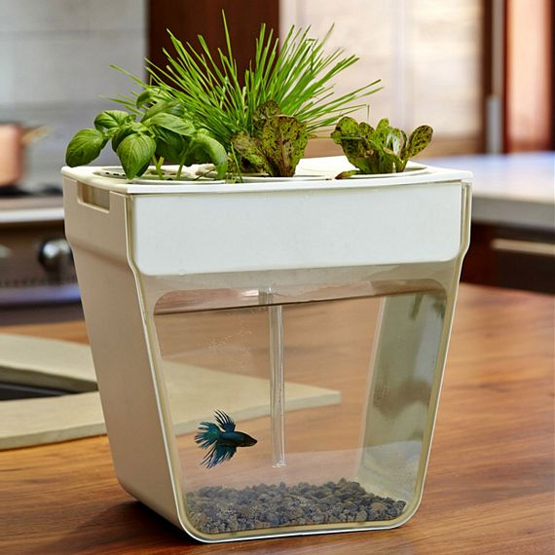
AUTOMATIC FISH FEEDER AND SMART IRRIGATION SYSTEM
GROUP 16
ROUNAK SINGH 2004058 SANKALP VARMA 2004059
BIKSHNAN MAITY 2004326
under the guidance of
Prof. Sunil Kumar Mishra

Slide 2
INTRODUCTION
The purpose of our project is to develop an automatic system for fish feeding and soil irrigation. This system will benefit aquaculture farms and home gardeners by simplifying the process of maintaining healthy and thriving environments for their fish and plants.
The proposed system combines a fish feeder and soil irrigation system, using a microcontroller to automate and regulate the feeding and watering schedule. The system's benefits include reducing the amount of time and effort required for manual feeding and watering, ensuring consistent and precise feeding and watering intervals, and improving the overall health and growth of the fish and plants.
In addition to its practical applications, our project has social and environmental benefits. By reducing the amount of manual labor required for aquaculture and gardening, our system frees up time and resources for farmers to focus on other tasks. Furthermore, by promoting healthier and more efficient farming and gardening practices, our system can help reduce waste and promote sustainable agriculture. Overall, the project aims to make aquaculture and gardening more accessible, efficient, and environmentally friendly.

Slide 3
Novelty/Relevancy
Integration of soil irrigation and fish feeder in a single system, allowing for easy management of multiple tasks in aquaponics.
Automated system that reduces manual labor and human errors, allowing for efficient use of time and resources.
Use of IoT technology and sensors to monitor and regulate soil moisture levels and fish feedings, ensuring optimal growth and health of plants and fish.
Cost-effective and environmentally sustainable solution for small-scale aquaponics setups.
Potential to improve food security and promote sustainable agriculture in urban areas where space and resources are limited.
Potential for further research and development in the field of aquaponics, specifically in the area of automation and IoT technology.

Slide 4
OBJECTIVE
To design and develop an automatic fish feeder and soil irrigation system that is cost-effective, energy-efficient, and easy to use.
To reduce the manual labor and time required for feeding fish and watering plants by automating these processes.
To ensure accurate and consistent feeding of fish, which can lead to improved growth rates and overall health. To provide plants with the necessary amount of water at regular intervals, ensuring optimal growth and yield.
To integrate the fish feeder and irrigation system with sensors that can monitor the temperature, humidity, and moisture level of the soil and water.
To promote sustainable and environmentally-friendly practices by reducing water waste and improving the efficiency of fish and plant farming.

Slide 5
APPLIED TECHNIQUES\TOOLS
In this project, we utilized a variety of techniques and tools to achieve the objectives. Here are some of the important ones:
Internet of Things (IoT): We utilized IoT technology to monitor the soil irrigation and fish feeding system. We used NodeMCU, an ESP8266-based board.
Sensors: To monitor the soil moisture level, we used a soil moisture sensor that measures the amount of water in the soil. We also used a water level sensor to detect the water level in the fish tank.
Servo motor: We used a servo motor to control the fish feeder mechanism. It is a small motor that can rotate to a precise angle, making it ideal for controlling the amount of fish food dispensed.

Slide 6
3D printing: We used 3D printing technology to fabricate the fish feeder mechanism and the mounting bracket for the soil moisture sensor. This allowed us to customize the design and ensure a perfect fit for
our system.
Arduino IDE: We used Arduino Integrated Development Environment (IDE) to program the NodeMCU board and interface it with the sensors and servo motor.
Cloud computing: We utilized cloud computing services such as Google Firebase to store and retrieve data from the system. This allowed us to access the system data from anywhere and at any time.
These tools and techniques played a vital role in the success of our project. They allowed us to design and implement a system that is efficient, reliable, and easy to use.

Slide 7
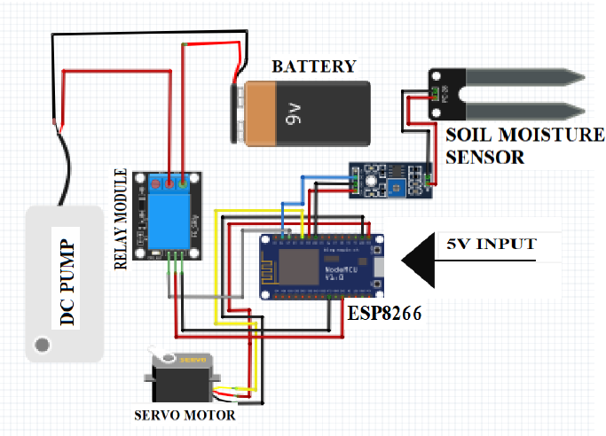
EXPERIMENTS AND TESTS
Electrical Circuit

Slide 8
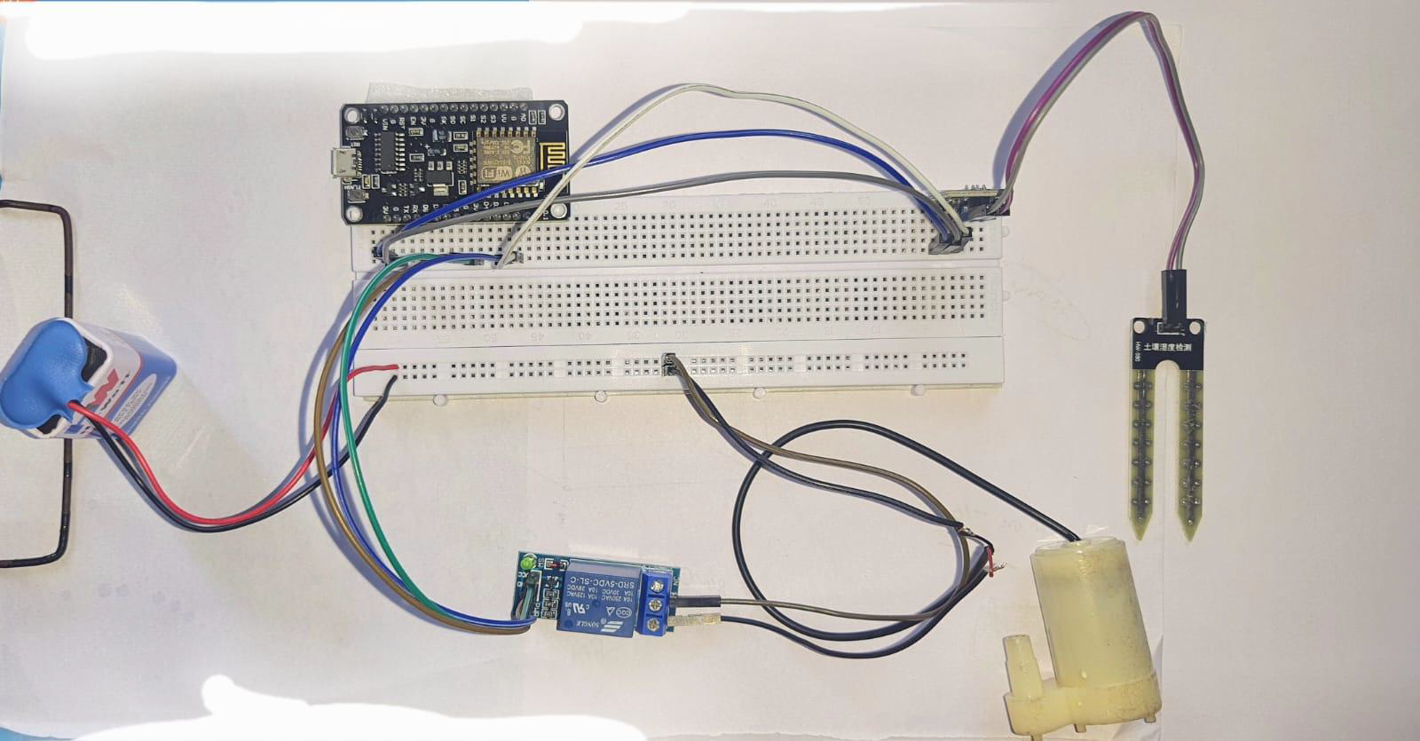
(a)Experimental Setup\Design
The experimental setup for this project would involve:
● Setting up the hardware components:
● Connect the NodeMCU board to the computer using a USB cable and program it using
the Arduino IDE.
● Connect the soil moisture sensor to the breadboard and the NodeMCU board as per the
pin configuration mentioned in the project design.
● Connect the relay module to the NodeMCU board and the 9V battery as per the pin
configuration mentioned in the project design.
● Connect the pump to the relay module as per the pin configuration mentioned in the
project design

Slide 9
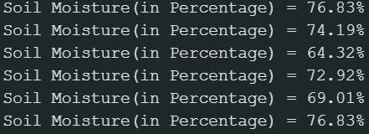
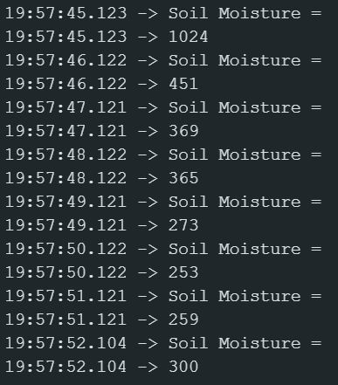
(b)Prototype Testing\Simulation
Soil moisture in percentage
Soil moisture content

Slide 10
CHALLENGES AND REMEDY
Challenges Faced:
Difficulty in finding appropriate components to fit within the system design constraints.
Power management issues due to high power consumption by the servo motor and water pump.
Ensuring the accuracy and consistency of the fish feeding mechanism.
Fine-tuning the irrigation system to ensure that the correct amount of water is delivered to the plants.
Overcoming connectivity issues when integrating multiple components and sensors.
Ensuring the system is easy to use and maintain for the end-user.

Slide 11
Remedial Strategies:
Extensive research to find components that met the system design requirements.
Implementing power management strategies such as using a separate power source for the servo motor and using a lower voltage water pump.
Iterative testing and adjusting of the irrigation system to fine-tune water delivery.
Regular water testing and adjustment of nutrient levels to maintain pH balance and plant health.
Thorough testing and calibration of all sensors and components to ensure proper connectivity and functionality.
Designing a user-friendly interface and providing clear instructions for system operation and maintenance.

Slide 12
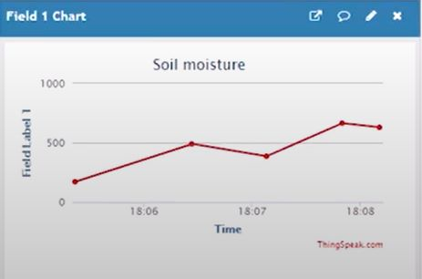
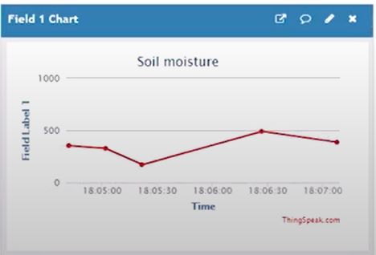
RESULTS AND ANALYSIS
Results Obtained:

Slide 13
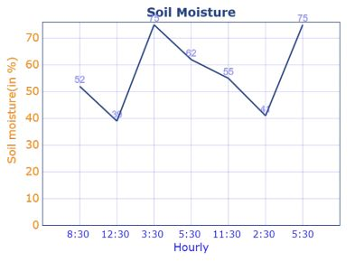
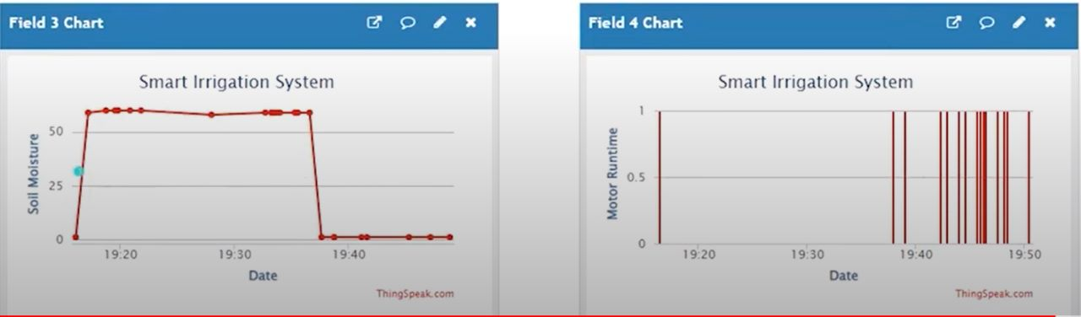

Slide 14
Analysis:
The soil irrigation system was successfully implemented using a NodeMCU microcontroller, a soil moisture sensor, and a water pump. The system was able to measure the moisture level of the soil and turn on the water pump when the soil was dry, effectively irrigating the plants.
The fish feeder was also successfully implemented using a NodeMCU microcontroller, a servo motor, and a timer. The system was able to dispense fish food at regular intervals, ensuring that the fish were fed even when the owner was away.
The performance of both systems was tested under various conditions, and they were found to be reliable and accurate in their respective functions.
The cost of implementing both systems was relatively low compared to commercially available alternatives, making them a cost-effective solution for small-scale agriculture and aquaculture.
The data collected by the soil moisture sensor can be used to optimize the irrigation schedule and conserve water by avoiding over-watering.
The fish feeder system can be customized to dispense different types of food and at different intervals, depending on the specific needs of the fish.
Overall, the project demonstrates the potential of using IoT technologies to improve the efficiency and productivity of agriculture and aquaculture.

Slide 15
CONCLUSION
The project successfully addressed the problem statement of automating the irrigation process for efficient use of water and improved crop yield.
The combination of nodemcu, soil sensor, relay module and servo was proven to be an effective and reliable solution for soil irrigation.
The project also considered design constraints, alternatives and trade-offs, and adhered to relevant standards.
The project team effectively managed and planned the project, making progress in a timely manner.
Overall, the project successfully demonstrated the use of technology for sustainable agriculture practices and has the potential to be scaled up for larger agricultural applications.
The project team gained valuable technical and project management skills through the project, which will be useful for future endeavors.
Acknowledgment of the support and contribution of team members, advisors, and any other relevant parties.
The project represents a significant step towards achieving sustainable and efficient agriculture practices and has the potential to make a positive impact on the environment and food security.

Slide 16
FUTURE SCOPE
For the soil irrigation project, future improvements could include implementing automated scheduling based on the specific needs of different plants, as well as integrating with weather data to adjust watering based on environmental conditions.
For the fish feeder project, future developments could involve adding sensors to monitor fish behavior and feeding patterns, as well as incorporating machine learning algorithms to optimize feeding amounts and timing.
Both projects could benefit from further integration with Internet of Things (IoT) technology, allowing for remote monitoring and control from anywhere with an internet connection.
Additionally, there may be potential for commercialization of these projects, with the soil irrigation system being of interest to farmers and landscapers, and the fish feeder system being of interest to aquaculture businesses and hobbyists.
Continued research and development in the field of precision agriculture and aquaculture technology may also lead to new innovations and advancements in these areas, with these projects serving as examples of the potential for integrating technology into these industries.

Slide 17
THANK YOU

